Slide 1



CRACK THE CASE
ROUND 3
TEAM NAME- TCS (TELIARGANJ CONSULTANCY SERVICE)
SIDDHI TANEJA(20226141)

Slide 2

PROBLEM STATEMENT
The objective of this Power BI project is to analyze survey responses from the food and beverage industry to gain insights into consumer behavior, preferences, and perceptions. The analysis will help identify key trends, understand brand perception, and explore potential areas for improvement in product offerings and marketing strategies.
Datasets:
Fact Table: fact_survey_responses
Dimension Table: dim_respondent
Dimension Table: dim_cities

Slide 3
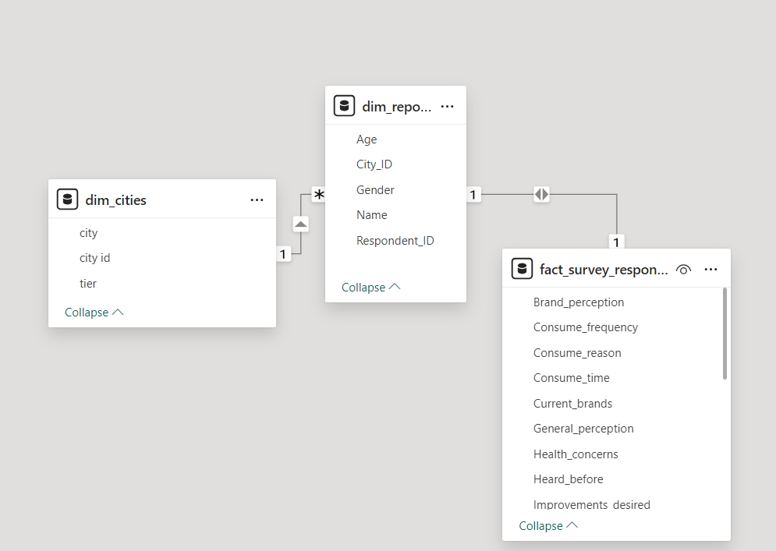

DATA CLEANING
CSV file to excel workbook conversion.
Load Data and Transform.
3. Join tables on Power-BI.
4. Main dashboard.

Slide 4
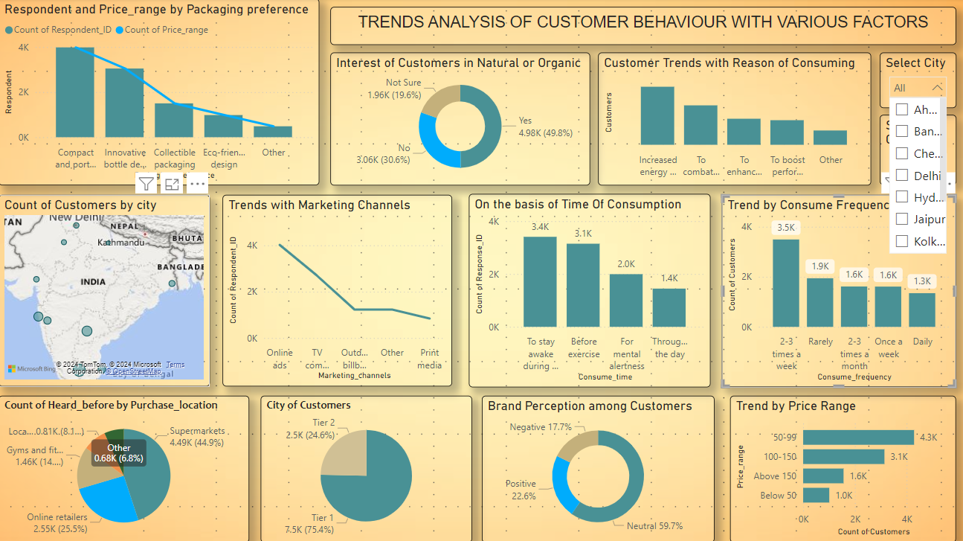

Slide 5

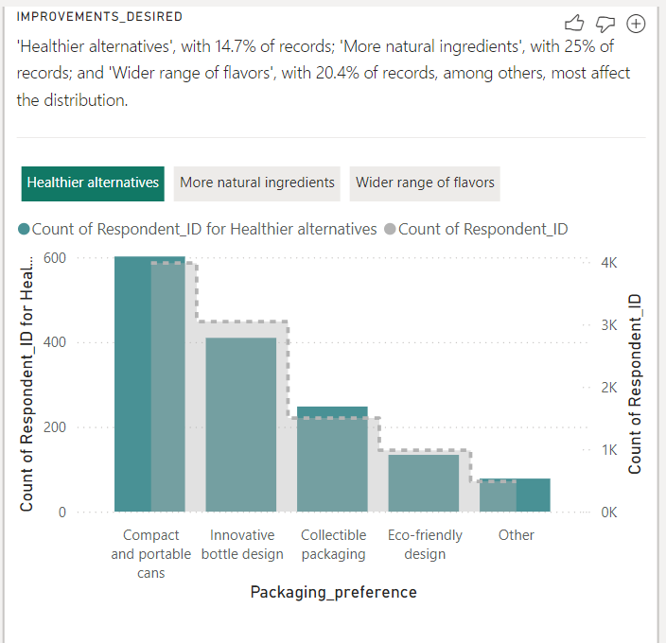
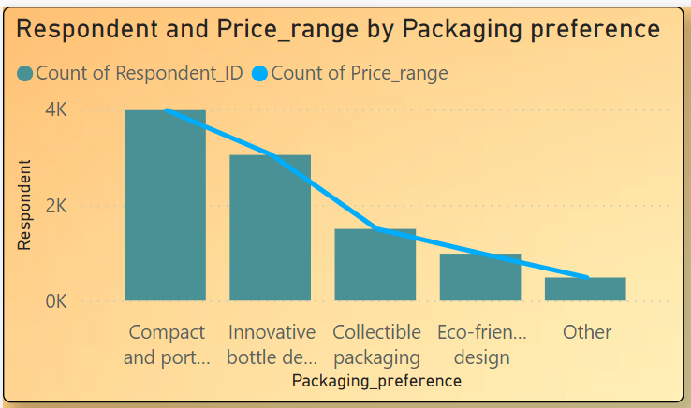
ANALYSIS

Slide 6
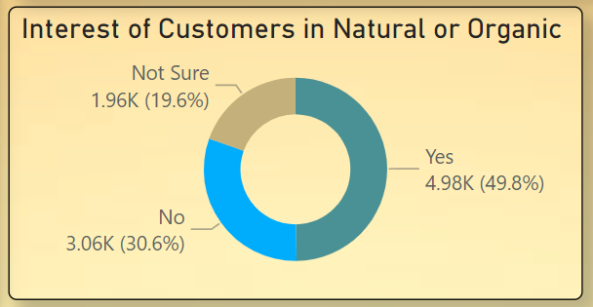
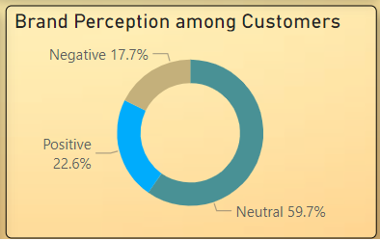
ANALYSIS

Slide 7
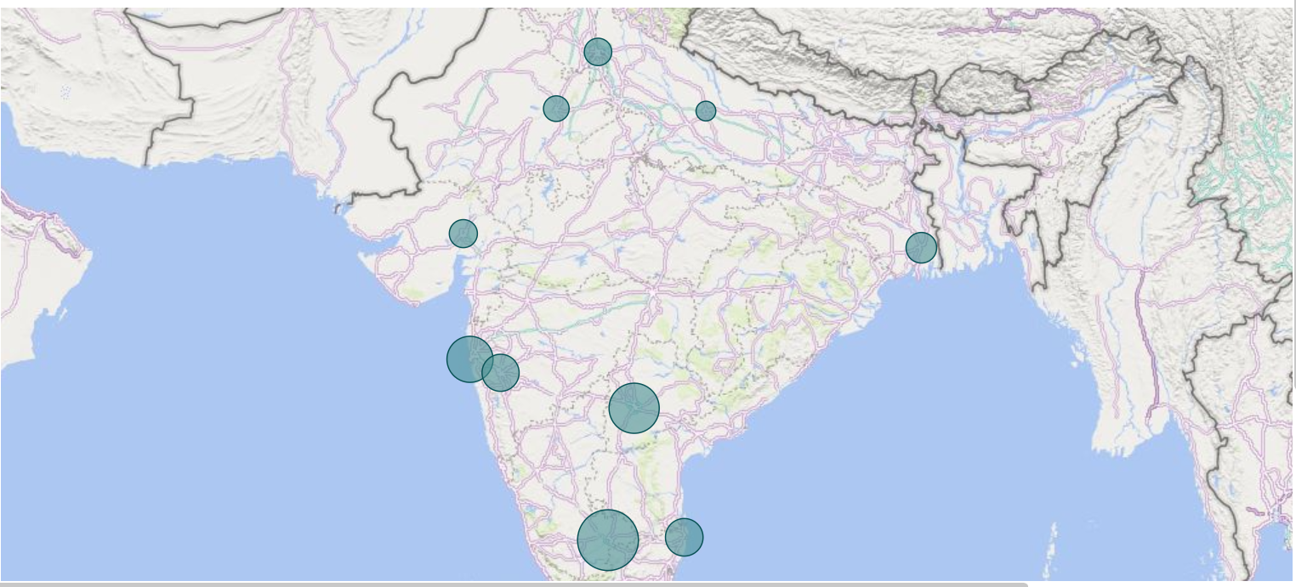
ANALYSIS

Slide 8
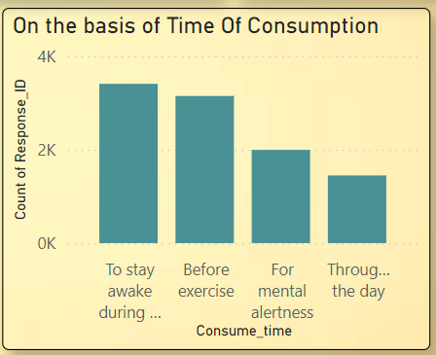
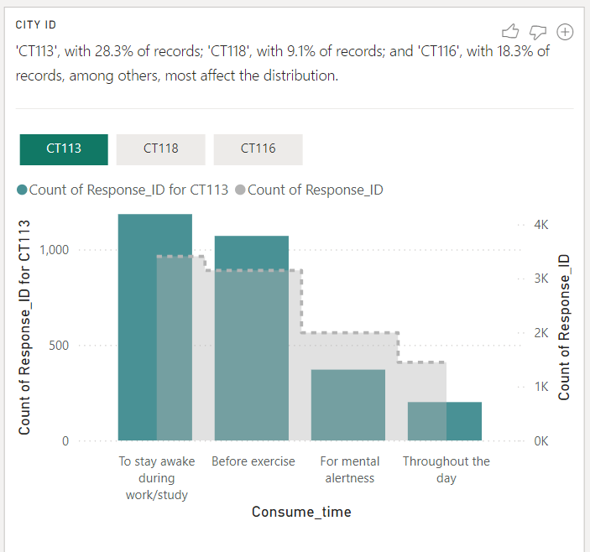
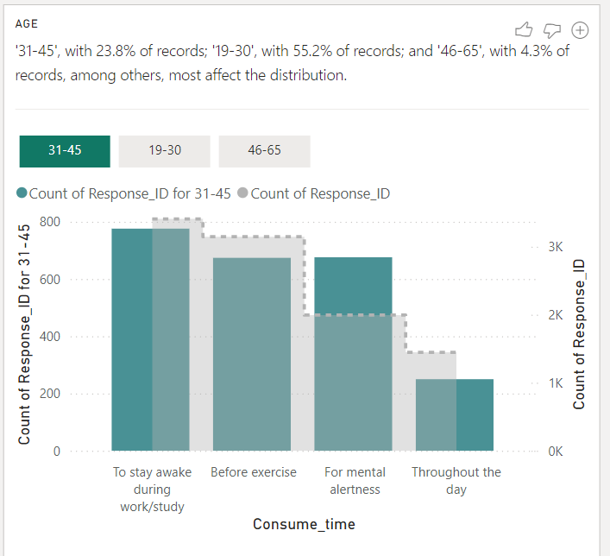
ANALYSIS

Slide 9
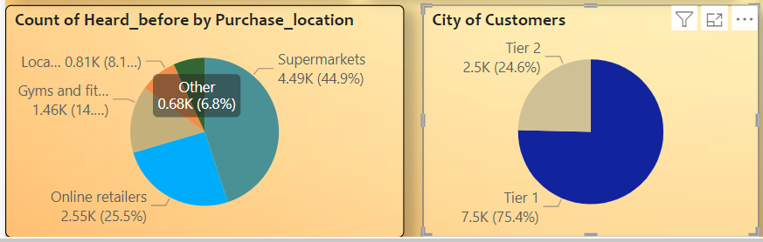
ANALYSIS

Slide 10
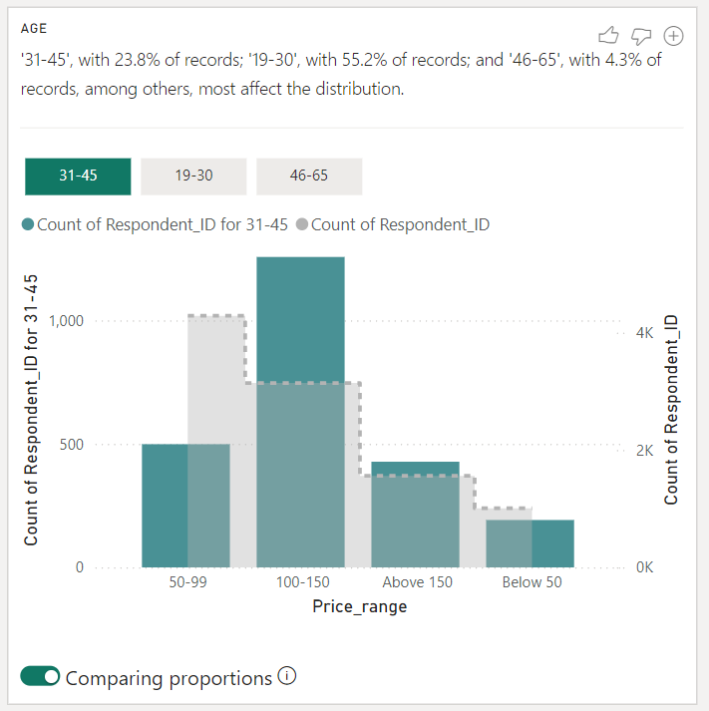
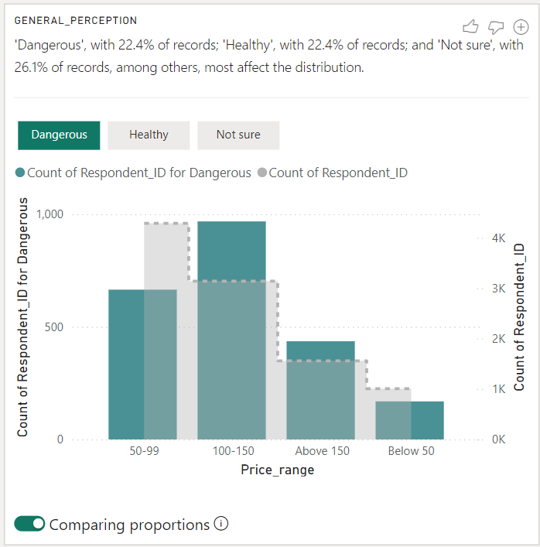
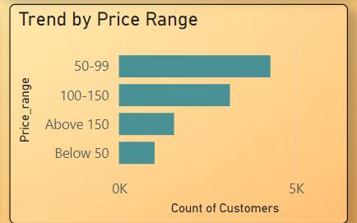
ANALYSIS

Slide 11
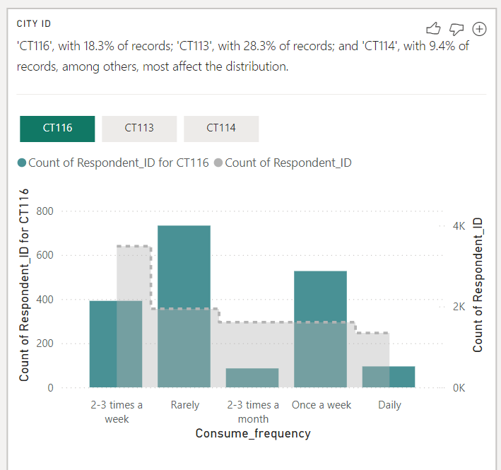
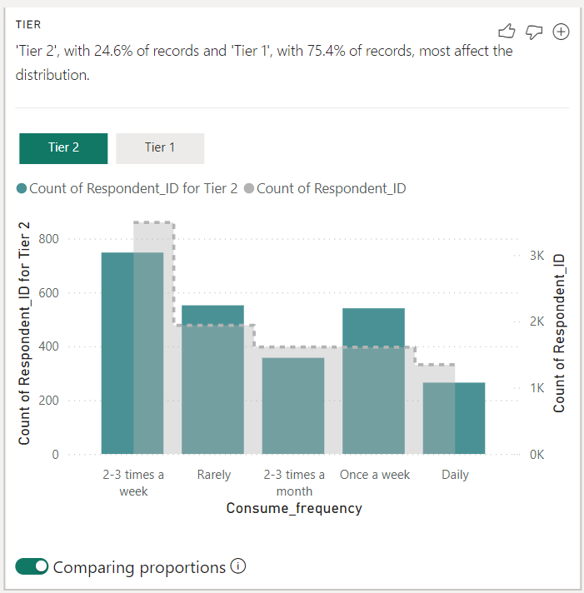
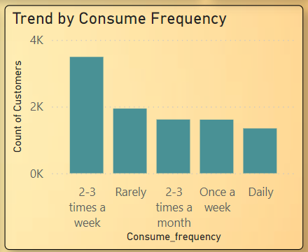
ANALYSIS

Slide 12
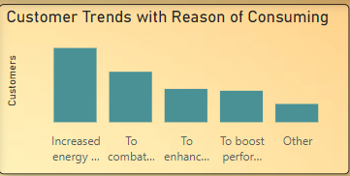
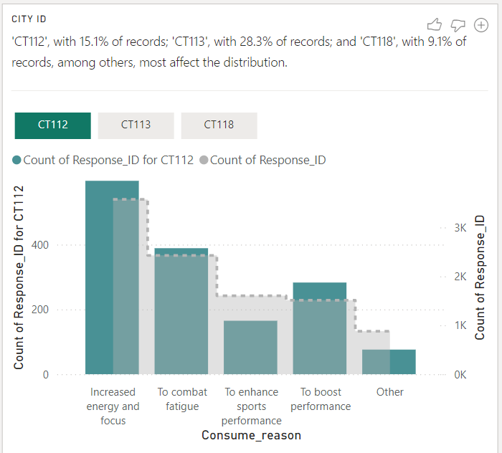
ANALYSIS

Slide 13
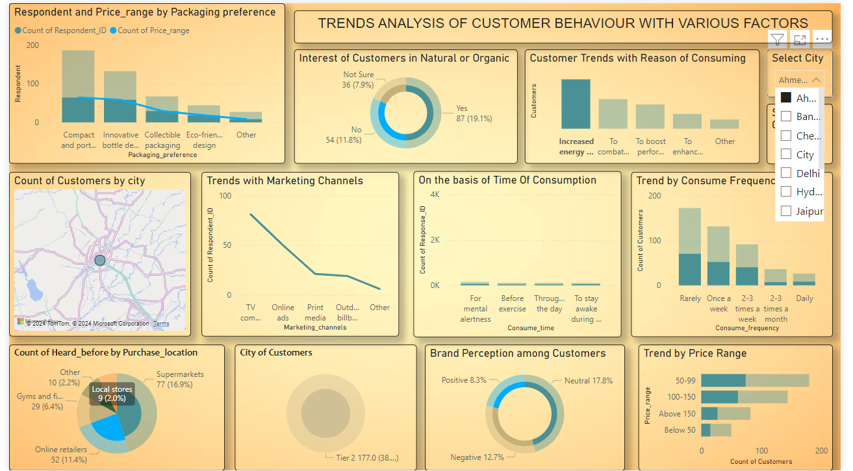
ANALYSIS

Slide 14

THANK YOU!
Aritra
Vedang
Siddhi

